Slide 1
Computing Near-Optimal Stable Cost Allocations for Cooperative Games by Lagrangian Relaxation
By:Lindong Liu, Xiangtong Qi, Zhou Xu
INFORMS Journal on Computing
Chaoyang Guo 2023.10.18
Notes:
Make-to-Order Products 按订单生产
An offline (online) approach is less (more) responsive to new job arrivals and, hence, often results in longer (shorter) job waiting time, which may negatively (positively) impact timely delivery of jobs. On the other hand, an offline (online) approach considers more (fewer) jobs together at a time and, hence, may generate a solution that is closer to (further from) global optimality 本文同时介绍 offline online 两种类型 并在数值实验中进行比较

Slide 2
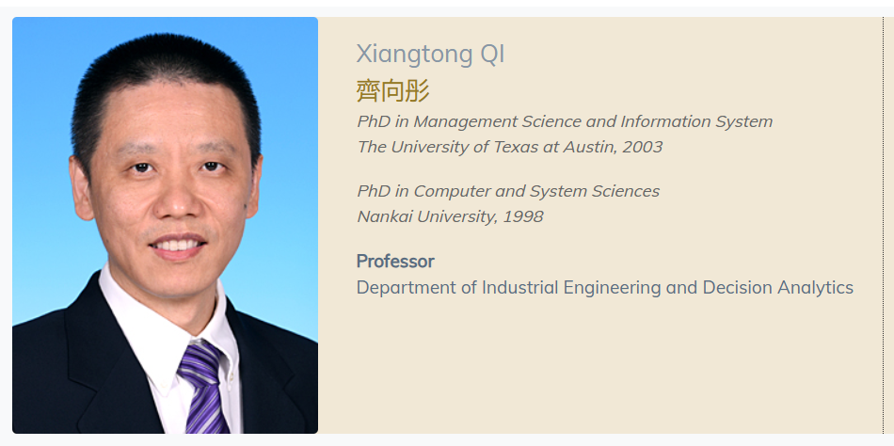
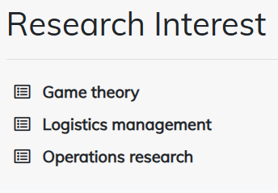

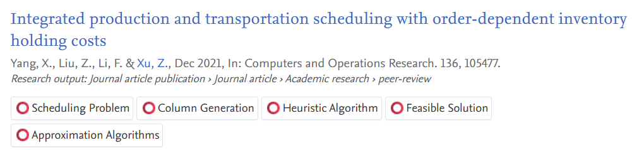
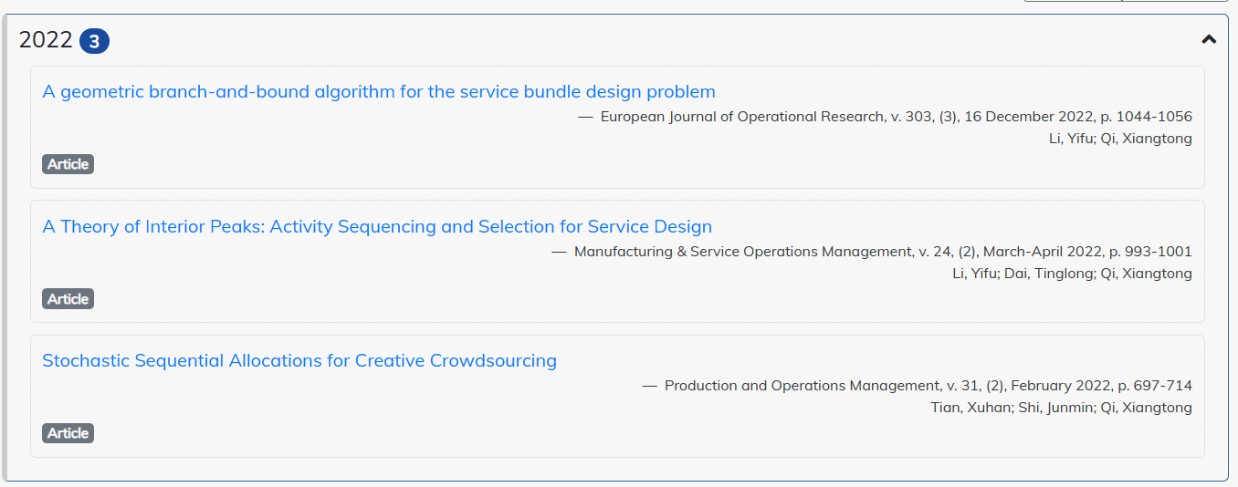
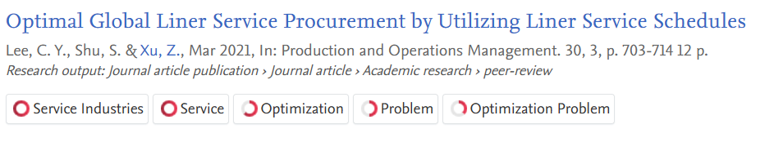
Author's Profile
齐向彤
徐宙
文献汇报
Notes:
China and Laos need to give up some of their own benefits to guarantee greater benefits at the system level under coalitions, especially China.
中国和老挝需要放弃自己的一些利益，以保证在联盟领导下的制度层面上获得更大的利益，特别是中国。

Slide 3
Introduction
Research gap：
1、the optimal cost allocation problem (OCAP) introduced by Caprara and Letchford (2010)
2、Caprara and Letchford (2010) developed an LP-based framework, referred to here in as the LPB algorithm
3、It is hard to identify all assignable constraints traveling salesman problem (TSP) game and vehicle routing game in Caprara and Letchford(2010).
unrooted traveling sales-man game studied in Caprara and Letchford (2010):(即使约束全部被识别，求解可能本身就是一个NP-hardness)
4、LRB（Lagrangian Relaxation-Based）
a generic framework；
also appicable to problems with nonlinear objectives;
the Lagrangian relaxation bound is no worse than the bound provided by the relaxed LP solution.
文献汇报
Notes:
China and Laos need to give up some of their own benefits to guarantee greater benefits at the system level under coalitions, especially China.
中国和老挝需要放弃自己的一些利益，以保证在联盟领导下的制度层面上获得更大的利益，特别是中国。

Slide 4
Literature Review
Related Research
OR applications
Shapley and Shubik 1971, Martínez-de Albéniz et al. 2013 | assignment games
Faigle and Kern 1993, Liu 2009 | bin packing games
Owen 1975 | linear production games
Granot and Huberman 1981 | Minimum spanning tree games
Tamir 1989, Potters et al.1992 | traveling salesman games
Göthe-Lundgren et al.1996, Engevall et al. 2004 | vehicle routing games
(Hartmanet al. 2000, Chen 2009, Chen and Zhang 2009, He et al.2012, Zhang 2009 | inventory games
Aydinliyim and Vairaktarakis 2010, Cai and Vairak-tarakis 2012 | production outsourcing games
Deng et al. 1999 | packing and covering games on graphs
文献汇报
Notes:
China and Laos need to give up some of their own benefits to guarantee greater benefits at the system level under coalitions, especially China.
中国和老挝需要放弃自己的一些利益，以保证在联盟领导下的制度层面上获得更大的利益，特别是中国。

Slide 5
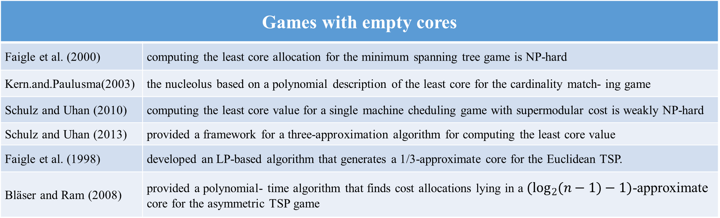
Literature Review
Games with empty cores | Games with empty cores
Faigle et al. (2000) | computing the least core allocation for the minimum spanning tree game is NP-hard
Kern.and.Paulusma(2003) | the nucleolus based on a polynomial description of the least core for the cardinality match- ing game
Schulz and Uhan (2010) | computing the least core value for a single machine cheduling game with supermodular cost is weakly NP-hard
Schulz and Uhan (2013) | provided a framework for a three-approximation algorithm for computing the least core value
Faigle et al. (1998) | developed an LP-based algorithm that generates a 1/3-approximate core for the Euclidean TSP.
Bläser and Ram (2008) | provided a polynomial- time algorithm that finds cost allocations lying in a $(\log_{2}(n−1)−1)$-approximate core for the asymmetric TSP game
Papers address the OCAP
Bachrach t al. (2009) | raised the problem of stabilizing the grand coalition of a cooperative game at a value that minimizes the subsidy,
Meir et al. (2011) | a similar study on restricted cooperation in coalitional games
Caprara and Letchford (2010) | algorithmic work on solving OCAP
文献汇报
Notes:
China and Laos need to give up some of their own benefits to guarantee greater benefits at the system level under coalitions, especially China.
中国和老挝需要放弃自己的一些利益，以保证在联盟领导下的制度层面上获得更大的利益，特别是中国。

Slide 6
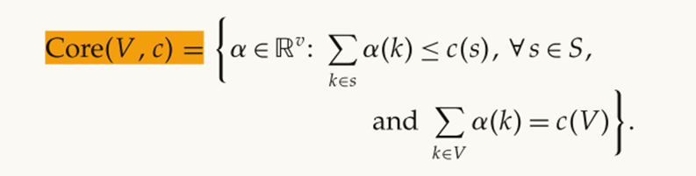
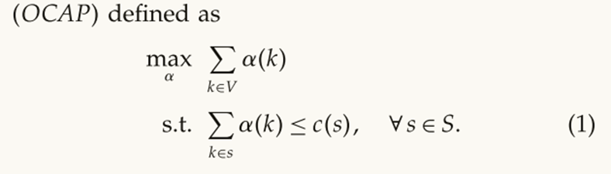
Preliminaries
Game theory
联盟保持稳定的约束
找到合作博弈的核
预算平衡约束
OCAP定义：
局中人承担的联盟的成本尽可能大
无退出动机
文献汇报
Notes:
China and Laos need to give up some of their own benefits to guarantee greater benefits at the system level under coalitions, especially China.
中国和老挝需要放弃自己的一些利益，以保证在联盟领导下的制度层面上获得更大的利益，特别是中国。

Slide 7
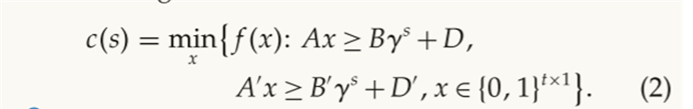
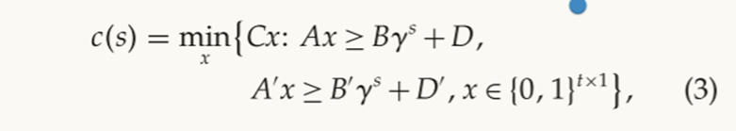
Preliminaries
Game theory
空核：The basic idea is to relax one of conditions specified in the definition of core
OR GAME:a generalization of the integer minimization(IM) game
The characteristic function of OR:(将约束分成两部分方便使用拉格朗日松弛)
线性或者非线性
The characteristic function of IM:（是OR的一种特殊情况）
线性
Caprara和Letchford（2010）：column-generation and row-generation for IM of OCAP
文献汇报
Notes:
China and Laos need to give up some of their own benefits to guarantee greater benefits at the system level under coalitions, especially China.
中国和老挝需要放弃自己的一些利益，以保证在联盟领导下的制度层面上获得更大的利益，特别是中国。

Slide 8
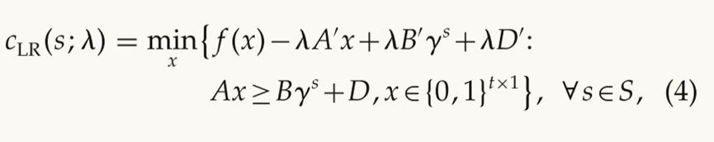
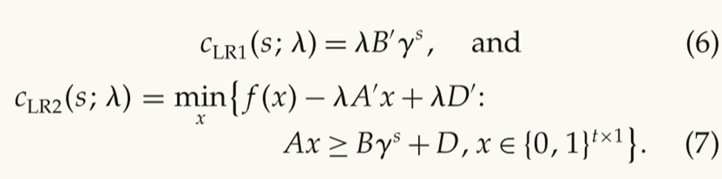
LRB Cost Allocation Algorithm
Relaxation and Game Decomposition
将约束用拉格朗日约束的形式加到特征函数中
求解拉格朗日对偶函数，找到最大λ值， the subgradient method (e.g., see Ahuja et al. 1993)
非空核
将原问题分成子博弈1和子博弈2：
最优拉格朗日乘子λ不一定对应最优的成本分配
定理1：子博弈的最优成本分配相加是博弈的最优成本分配。（文章中进行了证明）
可能是空核，LRB算法的有效性取决于该博弈
定理2:对于IM game，给出了在ILP特征函数下，LRB不劣于LPB充分条件。（证明略）
the Lagrangian multiplier is optimal for dual(V) of LR
子博弈成本分配是各自博弈的核
文献汇报
Notes:
China and Laos need to give up some of their own benefits to guarantee greater benefits at the system level under coalitions, especially China.
中国和老挝需要放弃自己的一些利益，以保证在联盟领导下的制度层面上获得更大的利益，特别是中国。

Slide 9
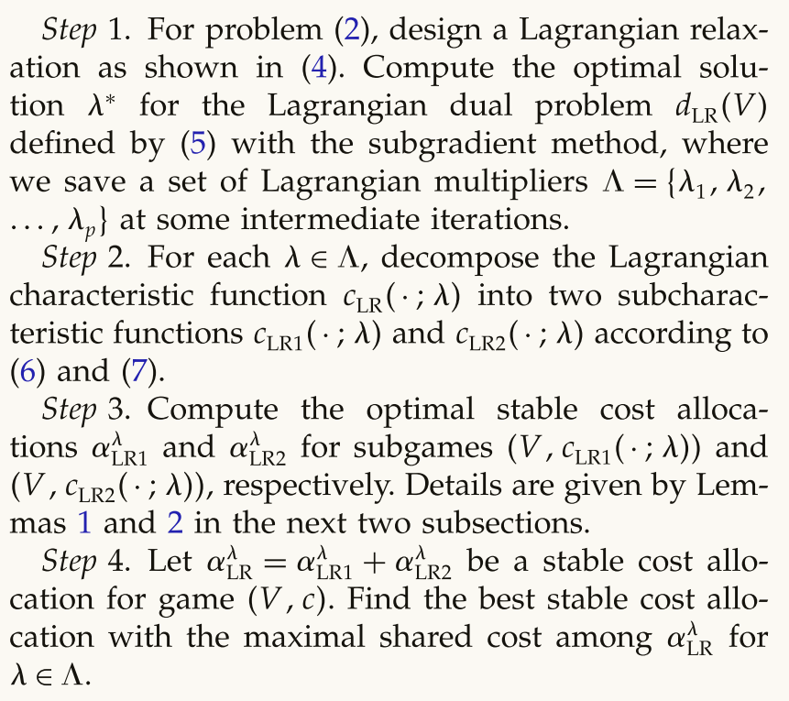
LRB Cost Allocation Algorithm
Algorithm 1
设计一个拉格朗日松弛问题，通过求解该问题的拉格朗日对偶问题，得到最优解。
将拉格朗日特征函数分解为两个子特征函数，分别对应子博弈1和子博弈2。
计算子博弈1和子博弈2的最优稳定成本分配，得到最优解。
将子博弈1和子博弈2的最优稳定成本分配合并，得到博弈的最终稳定成本分配。
非空核的话用最后迭代的最优乘子，空核的情况则需要用迭代中产生的5-6个最优拉格朗日乘子
文献汇报
Notes:
China and Laos need to give up some of their own benefits to guarantee greater benefits at the system level under coalitions, especially China.
中国和老挝需要放弃自己的一些利益，以保证在联盟领导下的制度层面上获得更大的利益，特别是中国。

Slide 10
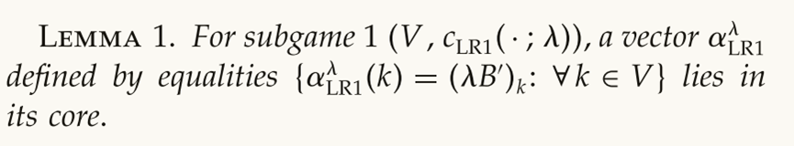
LRB Cost Allocation Algorithm
Solving Subgame
Subgame 1:
分配到的成本等于第K个人服务价格
该博弈可以直接计算出核的成本分配
C(S)可能是一个NP-Hardness
Subgame 2:
Method 1：(CGB) algorithm (see Barnhart et al. 1998 for an introduction on column generation)
Method 2：Caprara and Letchford (2010) suggests reformulating the master problem by treating each feasible solution of the optimization problem as a column.
The larger search space
文献汇报
Notes:
China and Laos need to give up some of their own benefits to guarantee greater benefits at the system level under coalitions, especially China.
中国和老挝需要放弃自己的一些利益，以保证在联盟领导下的制度层面上获得更大的利益，特别是中国。

Slide 11
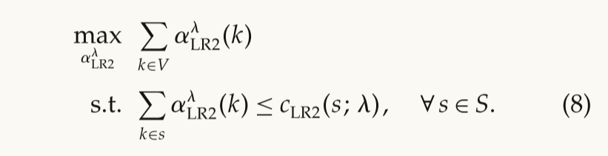
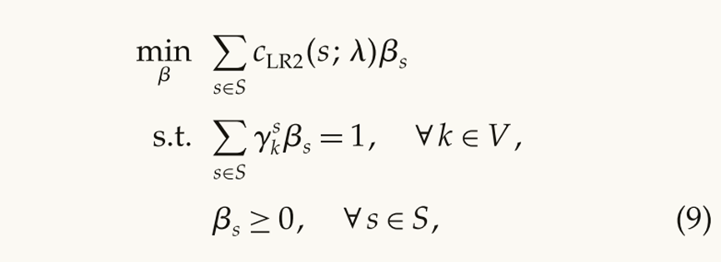
LRB Cost Allocation Algorithm
Solving Subgame –subgame 2
该最优解是相应OCAP问题的最优解
其对偶问题：
※为了计算该对偶问题，引入了算法2
文献汇报
Notes:
China and Laos need to give up some of their own benefits to guarantee greater benefits at the system level under coalitions, especially China.
中国和老挝需要放弃自己的一些利益，以保证在联盟领导下的制度层面上获得更大的利益，特别是中国。

Slide 12
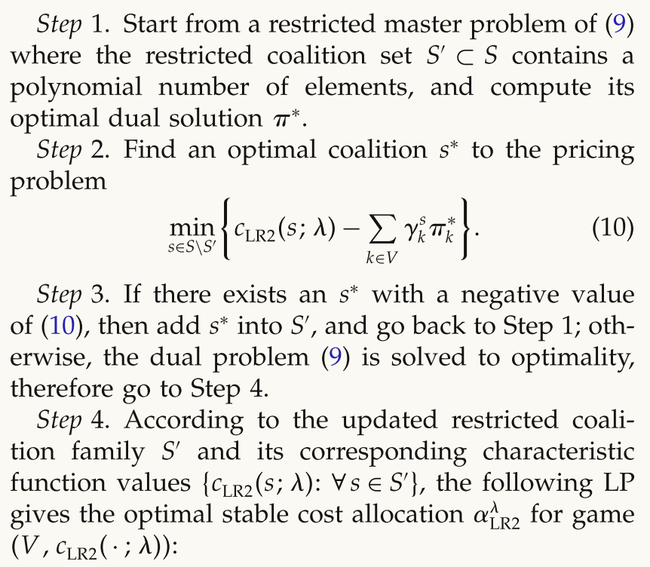
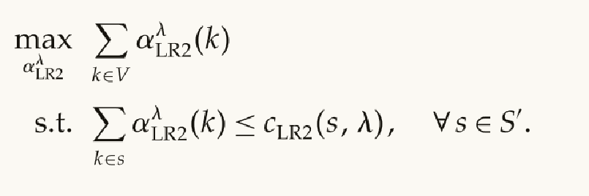
LRB Cost Allocation Algorithm
Solving Subgame –subgame 2
本质是寻找可以令联盟成本下降的集合。
对偶间隙最小，成本最小
更新后的联盟集，表示可以令分配成本更大的新联盟的加入
文献汇报
Notes:
China and Laos need to give up some of their own benefits to guarantee greater benefits at the system level under coalitions, especially China.
中国和老挝需要放弃自己的一些利益，以保证在联盟领导下的制度层面上获得更大的利益，特别是中国。

Slide 13
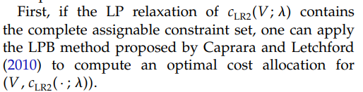
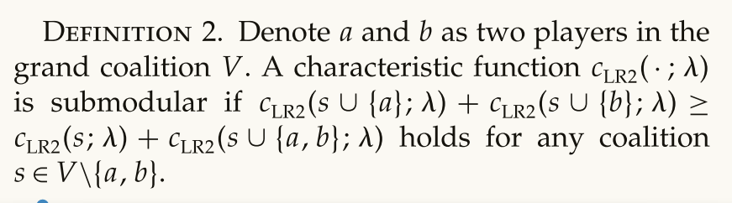
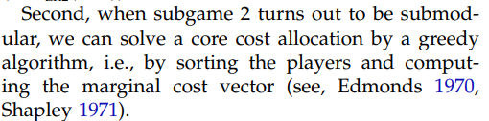
LRB Cost Allocation Algorithm
Solving Subgame –subgame 2
Two special cases:
全部的可分配约束集
含义：当一个个体玩家加入到一个更大的联盟中时，该个体玩家对整个联盟的边际贡献递减，即边际收益递减。
贪心算法
文献汇报
Notes:
China and Laos need to give up some of their own benefits to guarantee greater benefits at the system level under coalitions, especially China.
中国和老挝需要放弃自己的一些利益，以保证在联盟领导下的制度层面上获得更大的利益，特别是中国。

Slide 14
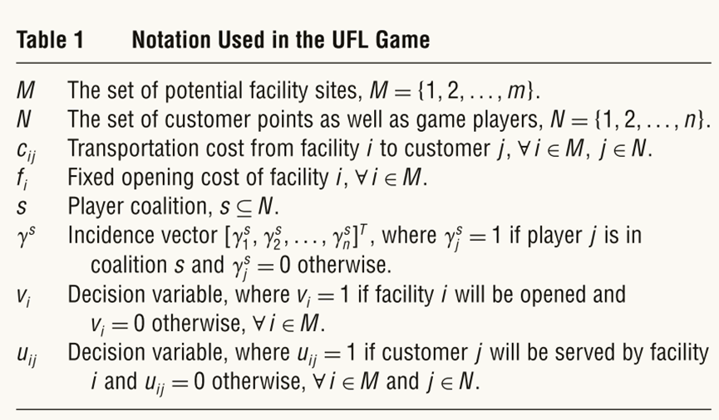
Implementations for FL
The UFL game
文献汇报
Notes:
China and Laos need to give up some of their own benefits to guarantee greater benefits at the system level under coalitions, especially China.
中国和老挝需要放弃自己的一些利益，以保证在联盟领导下的制度层面上获得更大的利益，特别是中国。

Slide 15
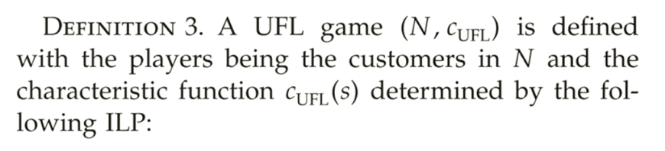
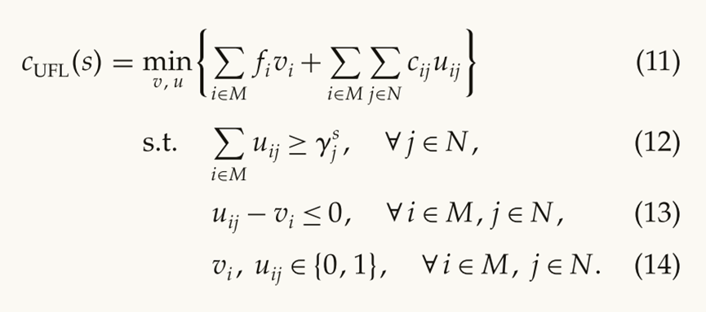
Implementations for FL
The UFL game
必须服务于联盟S中的每个客户
确保只有开放的设施可以服务于客户
次可加：对于任意的个体玩家加入到联盟中，该个体玩家对整个联盟的边际贡献递减，且递减的程度不会超过其他个体玩家加入时的边际贡献递减。
文献汇报
Notes:
China and Laos need to give up some of their own benefits to guarantee greater benefits at the system level under coalitions, especially China.
中国和老挝需要放弃自己的一些利益，以保证在联盟领导下的制度层面上获得更大的利益，特别是中国。

Slide 16
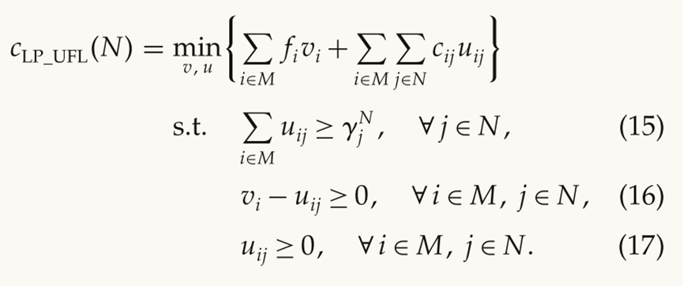
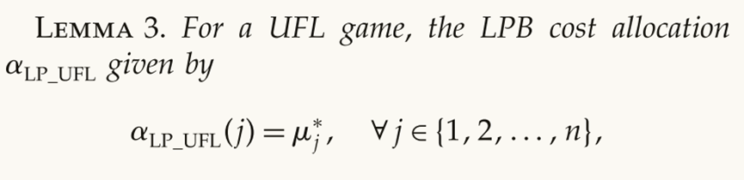
Implementations for FL
The UFL game——LPB
约束1-n
n+1-n+nm
equal in value
n+mn+1-n+2mn
对偶的最优解
文献汇报
Notes:
China and Laos need to give up some of their own benefits to guarantee greater benefits at the system level under coalitions, especially China.
中国和老挝需要放弃自己的一些利益，以保证在联盟领导下的制度层面上获得更大的利益，特别是中国。

Slide 17
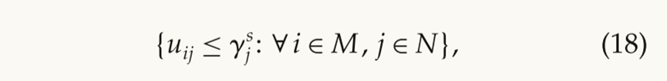
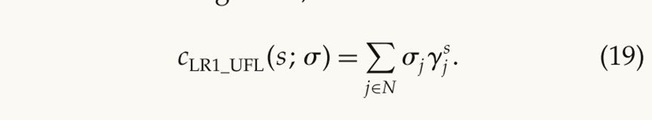
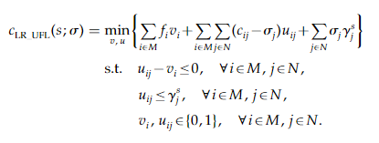
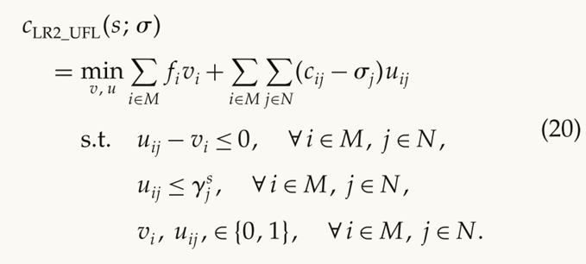
Implementations for FL
The UFL game-LRB
将该约束添加到目标函数构造拉格朗日松弛
表示顾客j不在联盟中不能得到服务
文献汇报
Notes:
China and Laos need to give up some of their own benefits to guarantee greater benefits at the system level under coalitions, especially China.
中国和老挝需要放弃自己的一些利益，以保证在联盟领导下的制度层面上获得更大的利益，特别是中国。

Slide 18
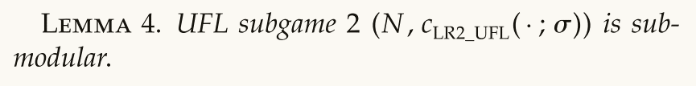
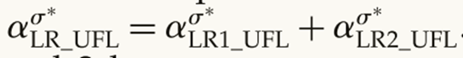
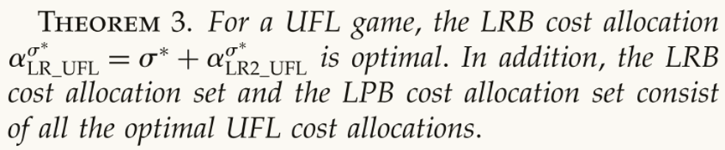
Implementations for FL
The UFL game-LRB
文中给出了证明
the submodularity of UFL subgame 2,：one can easily compute its core cost allocation by the greedy algorithm.
LRB的成本分配
定理三：说明了LPB和LRB最优分配方案之间的关系。
文献汇报
Notes:
China and Laos need to give up some of their own benefits to guarantee greater benefits at the system level under coalitions, especially China.
中国和老挝需要放弃自己的一些利益，以保证在联盟领导下的制度层面上获得更大的利益，特别是中国。

Slide 19
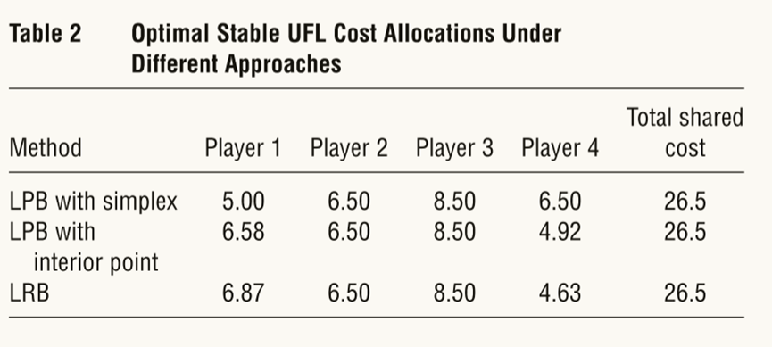
Implementations for FL
The UFL game-LRB
＃举例表明，LPB求解器可能遗漏某些最优解，LRB的解可能被排除在外
文献汇报
Notes:
China and Laos need to give up some of their own benefits to guarantee greater benefits at the system level under coalitions, especially China.
中国和老挝需要放弃自己的一些利益，以保证在联盟领导下的制度层面上获得更大的利益，特别是中国。

Slide 20
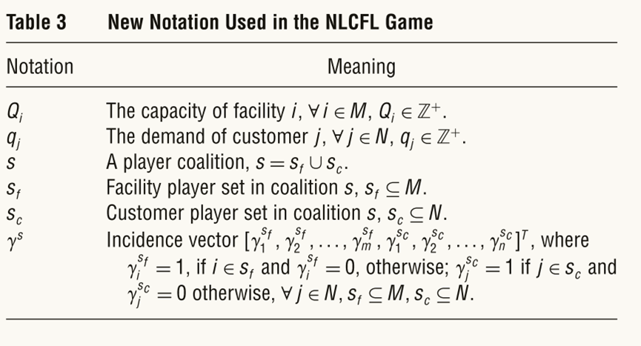
Implementations for FL
The NLCFL game
文献汇报
Notes:
China and Laos need to give up some of their own benefits to guarantee greater benefits at the system level under coalitions, especially China.
中国和老挝需要放弃自己的一些利益，以保证在联盟领导下的制度层面上获得更大的利益，特别是中国。

Slide 21
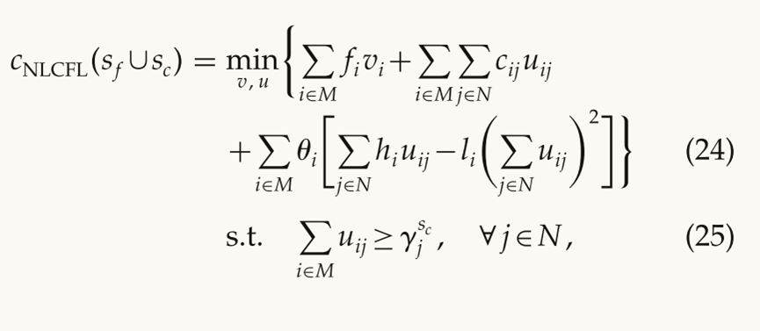
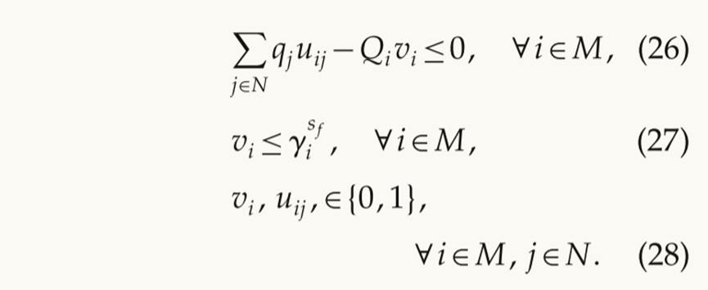
Implementations for FL
The NLCFL game
局中人由设施集和顾客集组成
Definition of NCUFL
二次函数模拟运营成本的规模经济
容量限制
设施存在于联盟中，才能服务顾客
文献汇报
Notes:
China and Laos need to give up some of their own benefits to guarantee greater benefits at the system level under coalitions, especially China.
中国和老挝需要放弃自己的一些利益，以保证在联盟领导下的制度层面上获得更大的利益，特别是中国。

Slide 22
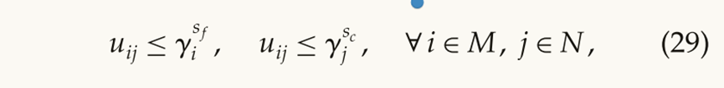
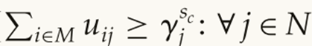
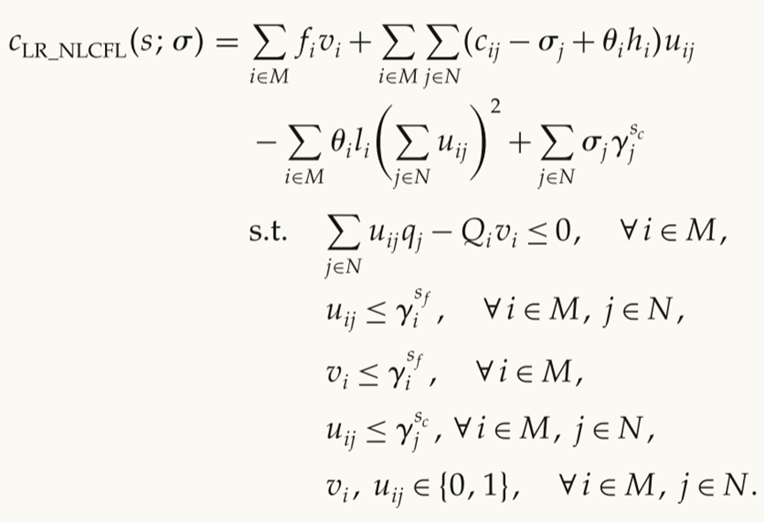
Implementations for FL
The NLCFL game
优化拉格朗日边界
构造拉格朗日松弛
文献汇报
Notes:
China and Laos need to give up some of their own benefits to guarantee greater benefits at the system level under coalitions, especially China.
中国和老挝需要放弃自己的一些利益，以保证在联盟领导下的制度层面上获得更大的利益，特别是中国。

Slide 23
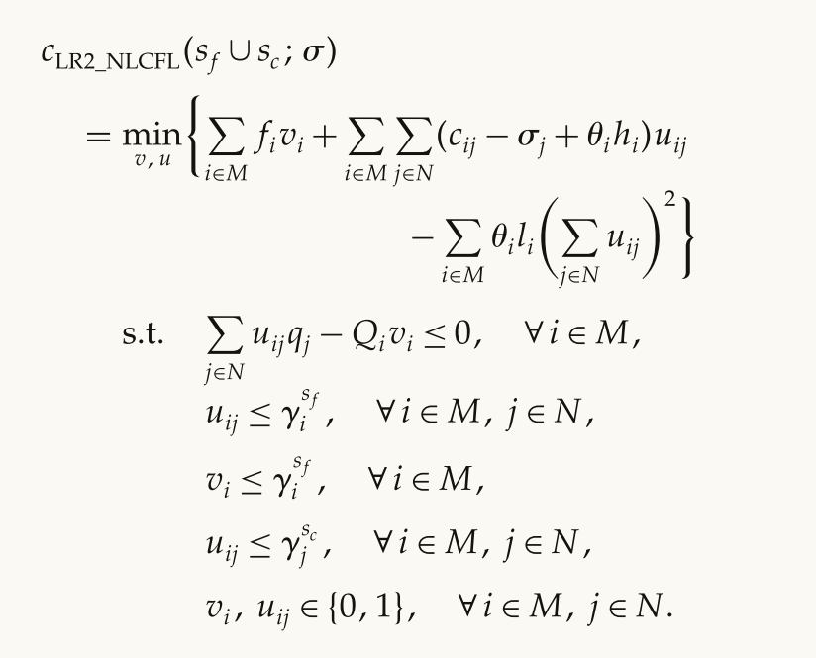
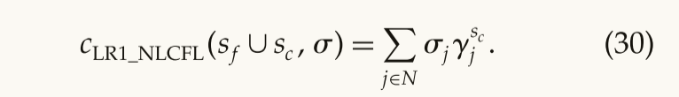
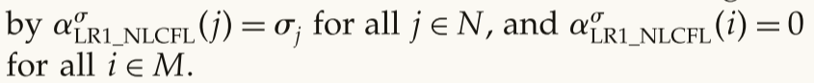
Implementations for FL
The NLCFL game-subgame1&2
设施不享受服务，分配成本为0
文献汇报
Notes:
China and Laos need to give up some of their own benefits to guarantee greater benefits at the system level under coalitions, especially China.
中国和老挝需要放弃自己的一些利益，以保证在联盟领导下的制度层面上获得更大的利益，特别是中国。

Slide 24
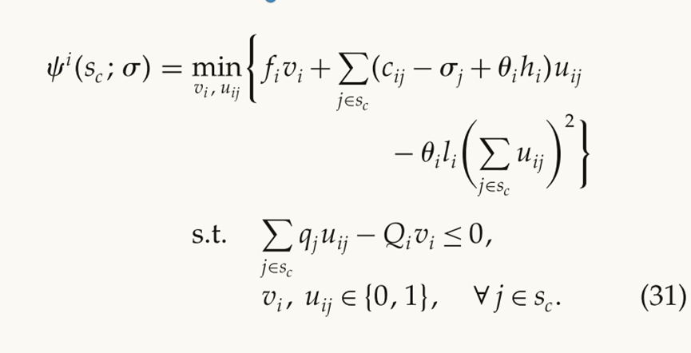
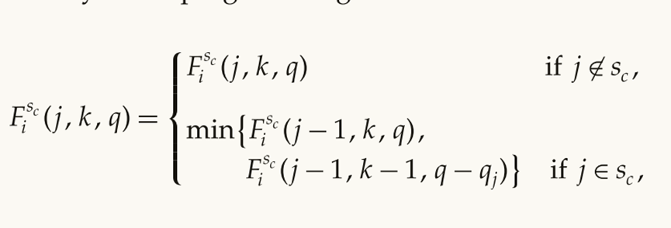
Implementations for FL
The NLCFL game-subgame2
按照设施分成单个设施的加和函数
背包问题的变体
动态规划求解：
文献汇报
Notes:
China and Laos need to give up some of their own benefits to guarantee greater benefits at the system level under coalitions, especially China.
中国和老挝需要放弃自己的一些利益，以保证在联盟领导下的制度层面上获得更大的利益，特别是中国。

Slide 25
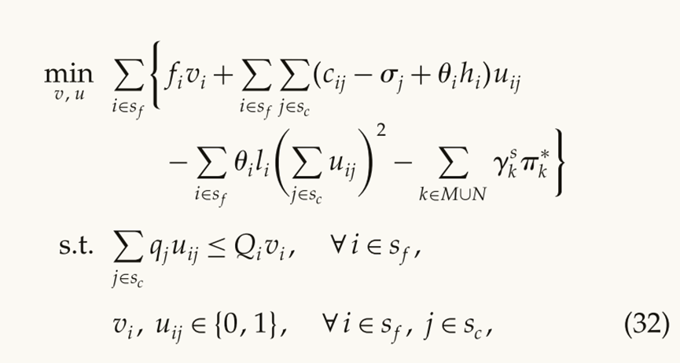
Implementations for FL
The NLCFL game-subgame2
NLCFL subgame 2 by the CGB algorithm：
CGB算法在目标函数中添加了一项关于对偶问题最优解的函数。这样，通过最小化目标函数，我们可以同时考虑到原始博弈和对偶问题的信息，从而得到更好的稳定成本分配。
文献汇报
Notes:
China and Laos need to give up some of their own benefits to guarantee greater benefits at the system level under coalitions, especially China.
中国和老挝需要放弃自己的一些利益，以保证在联盟领导下的制度层面上获得更大的利益，特别是中国。

Slide 26
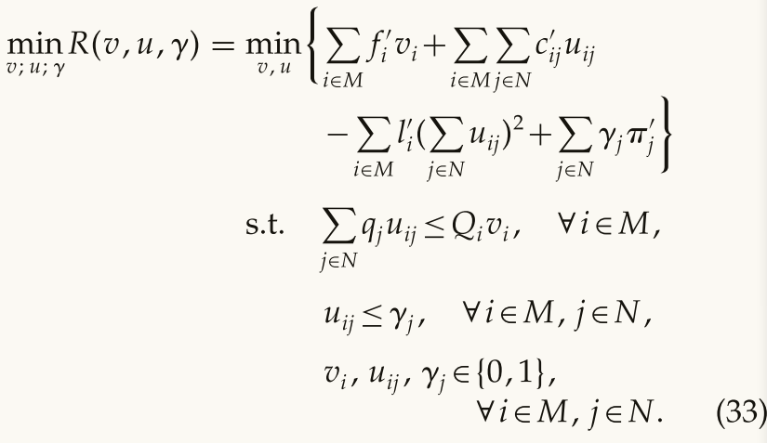
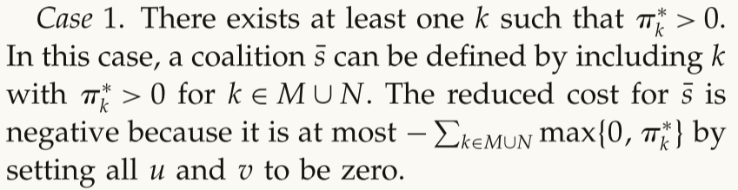
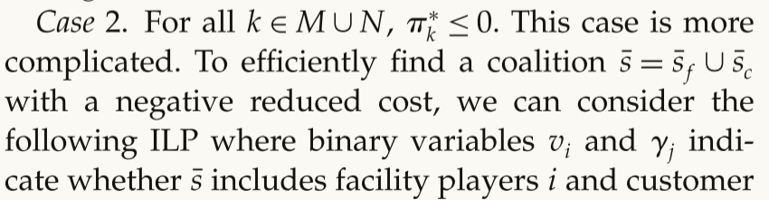
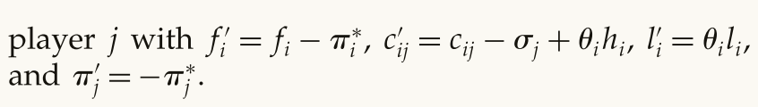
Implementations for FL
The NLCFL game-subgame2
Two cases of using of the CGB algorithm：
该函数令目标函数下降的可行解与令成本下降的可行联盟集合一一对应
为了便于求解，将一些不会影响最优分配方案的变量修改为0
文献汇报
Notes:
China and Laos need to give up some of their own benefits to guarantee greater benefits at the system level under coalitions, especially China.
中国和老挝需要放弃自己的一些利益，以保证在联盟领导下的制度层面上获得更大的利益，特别是中国。

Slide 27

Implementations for FL
The results for the NLCFL:
LRB算法下最好的成本分配方案
考虑运营成本相对权重下的联盟方案
最差能覆盖93.3%的联盟成本
文献汇报
Notes:
China and Laos need to give up some of their own benefits to guarantee greater benefits at the system level under coalitions, especially China.
中国和老挝需要放弃自己的一些利益，以保证在联盟领导下的制度层面上获得更大的利益，特别是中国。

Slide 28


Implementations for FL
The results for the NLCFL
LRB 优于 LPB
文献汇报
Notes:
China and Laos need to give up some of their own benefits to guarantee greater benefits at the system level under coalitions, especially China.
中国和老挝需要放弃自己的一些利益，以保证在联盟领导下的制度层面上获得更大的利益，特别是中国。

Slide 29

Implementations for FL
The results for the NLCFL
the best Lagrangian multiplier found within i iterations of the subgradient method in Step 1 of Algorithm 1
This finding confirms the need for using multiple Lagrangian multipliers in Algorithm 1.
文献汇报
Notes:
China and Laos need to give up some of their own benefits to guarantee greater benefits at the system level under coalitions, especially China.
中国和老挝需要放弃自己的一些利益，以保证在联盟领导下的制度层面上获得更大的利益，特别是中国。

Slide 30
Conclusion
cooperative games whose core may be empty
propose a generic framework to calculate a good stable cost allocation that satisfies coalitional stability and recovers the grand coalition cost as much as possible
algorithm is not restricted to solving problems with assignable constraints and linear objective functions
demonstrate our new algorithm on two different facility location games
文献汇报
Notes:
China and Laos need to give up some of their own benefits to guarantee greater benefits at the system level under coalitions, especially China.
中国和老挝需要放弃自己的一些利益，以保证在联盟领导下的制度层面上获得更大的利益，特别是中国。

Slide 31
Thank you for listening！
Chaoyang Guo

